Slide 1
Cobblestone edging
Type:

Slide 2
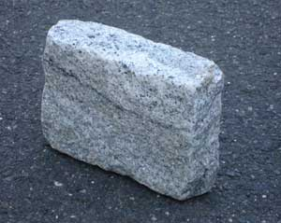
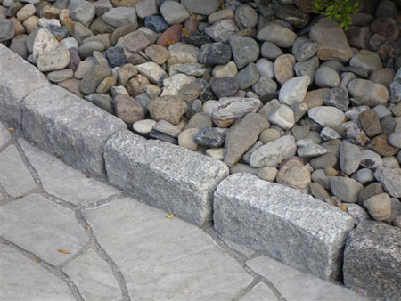
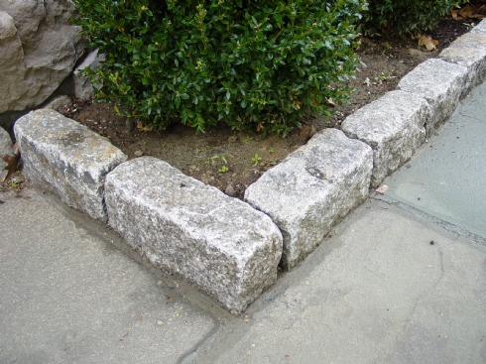
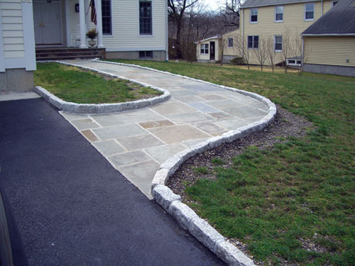
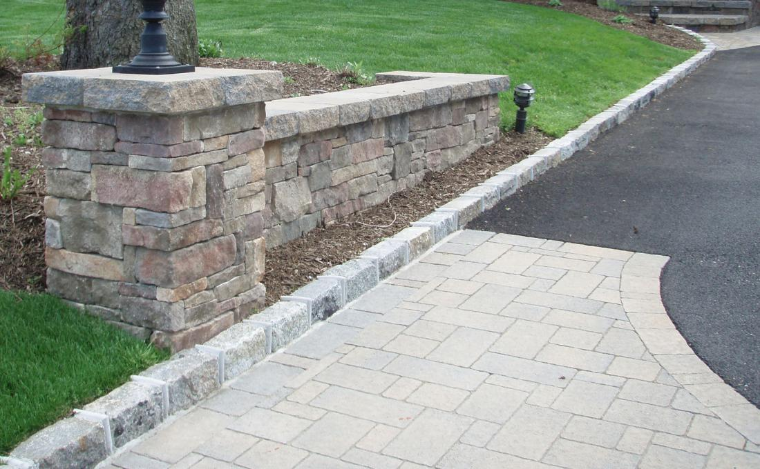

Slide 3
KAPO Construction & Masonry
Albion Kapo
(203) 560–7877
albi.kapo@live.com
www.kapo-construction-masonry.com

